Slide 1
Enlighten- NHS2048: The Future Health of Scotland Monday 27th October Mark Diffley, Founder and Director

Slide 2
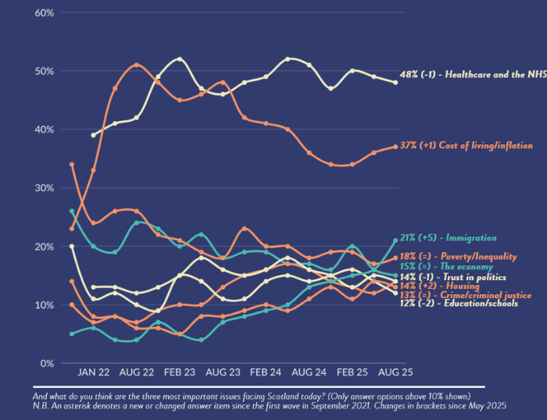
Healthcare and the NHS has consistently been seen as the most important issue facing Scotland….

Slide 3
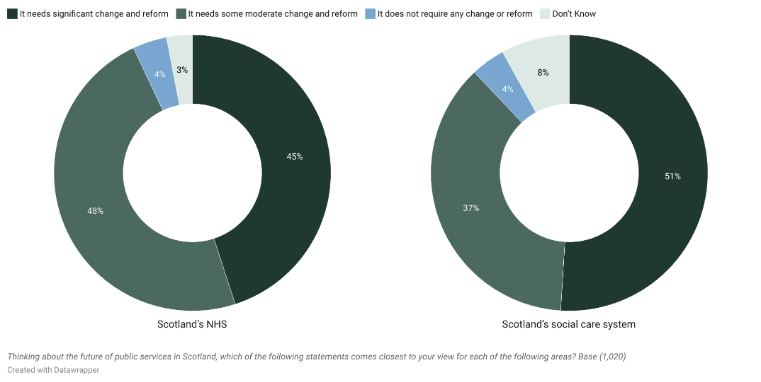
We support change/reform to NHS and social care…

Slide 4
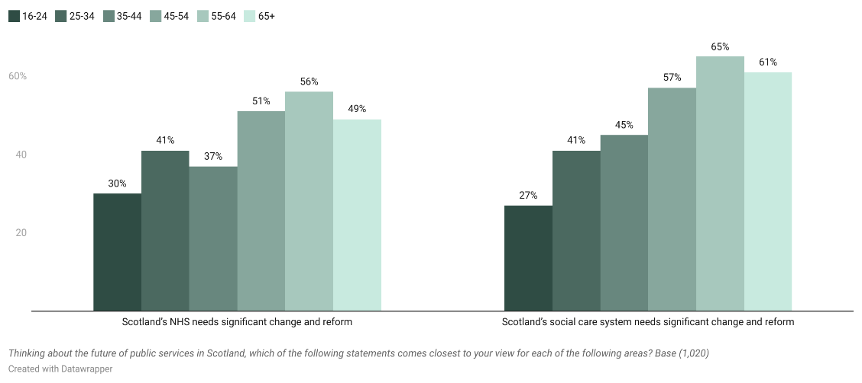
… particularly as we get older

Slide 5
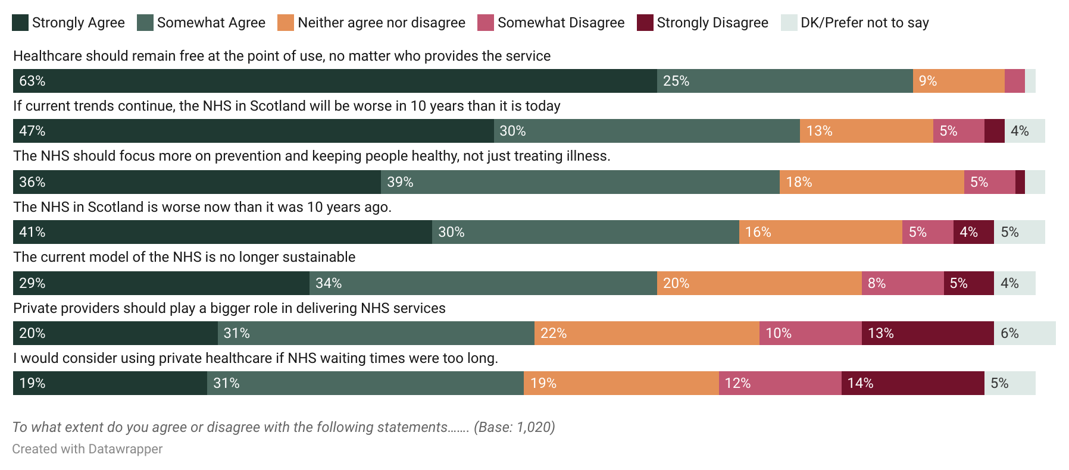
The ‘free at the point use’ principle remains critical

Slide 6
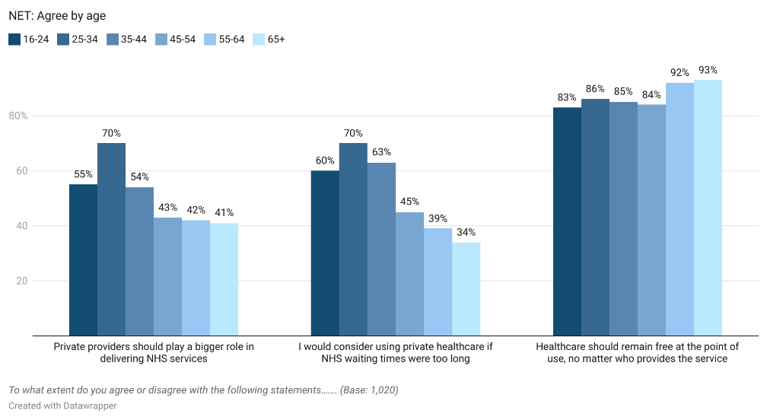
Older citizens are most resistant to private healthcare

Slide 7
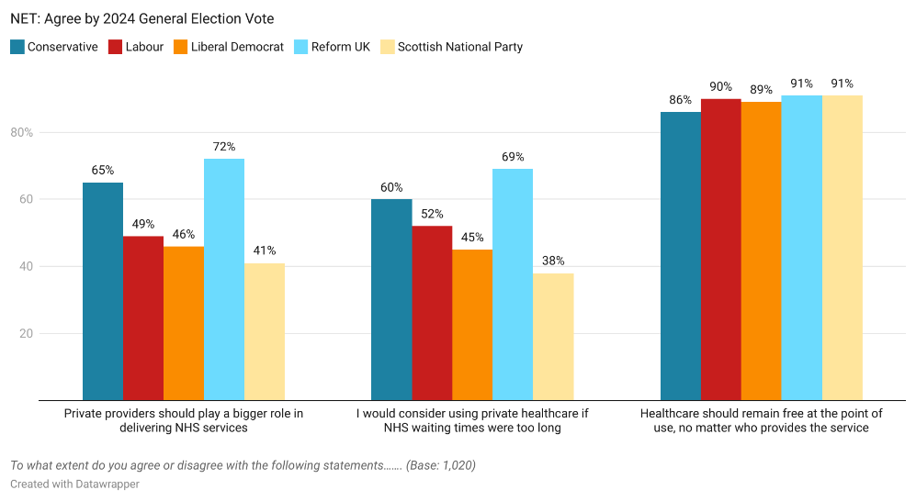
Party support is also important

Slide 8
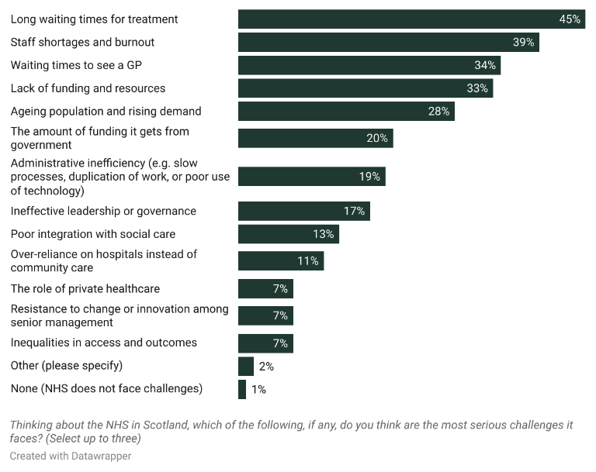
Waiting times, staffing, funding seen as key NHS challenges

Slide 9
And there is consistency across groups
Total | 16-24 | 65+ | Male | Female
Long waiting times for treatment (45%) | Long waiting times for treatment (49%) | Long waiting times for treatment (45%) | Long waiting times for treatment (42%) | Long waiting times for treatment (48%)
Staff shortages and burnout (39%) | Staff shortages and burnout (41%) | Ageing population and rising demand (37%) | Staff shortages and burnout (35%) | Staff shortages and burnout (42%)
Waiting times to see a GP (34%) | Lack of funding and resources (40%) | Staff shortages and burnout (32%) | Lack of funding and resources (34%) | Waiting times to see a GP (38%)
Lack of funding and resources (33%) | Waiting times to see a GP (40%) | Waiting times to see a GP (30%) | Ageing population and rising demand (33%) | Lack of funding and resources (32%)
Ageing population and rising demand (28%) | The amount of funding it gets from government (22%) | Lack of funding and resources (25%) | Waiting times to see a GP (30%) | Ageing population and rising demand (24%)
Thinking about the NHS in Scotland, which of the following, if any, do you think are the most serious challenges it faces? Select up to three (Base: 1,020)

Slide 10
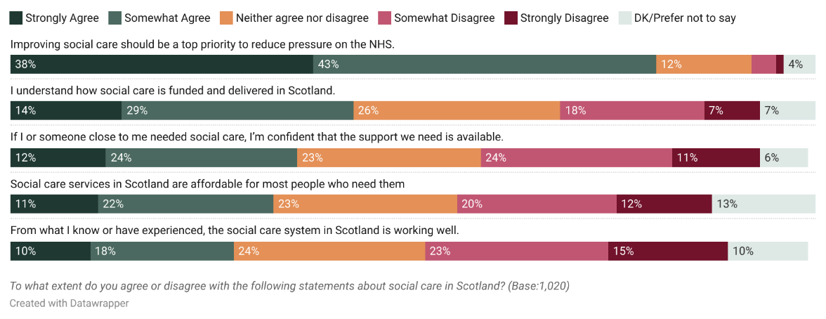
Fewer than 3 in 10 think social care is working well

Slide 11
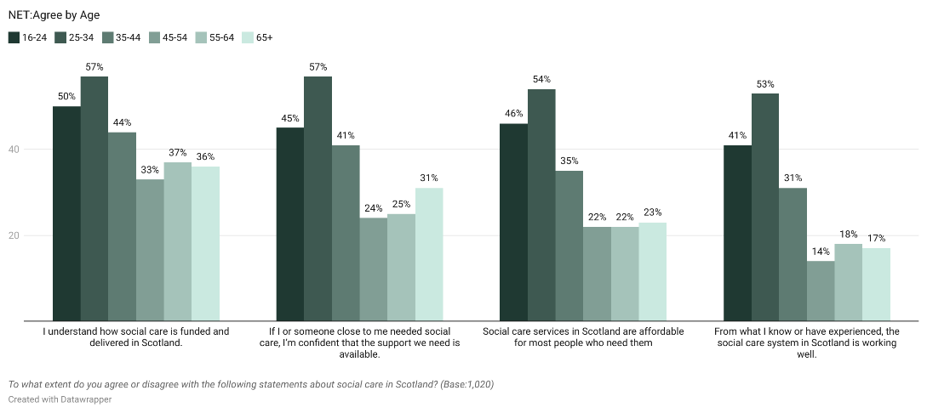
And is even lower among those most likely to need it

Slide 12
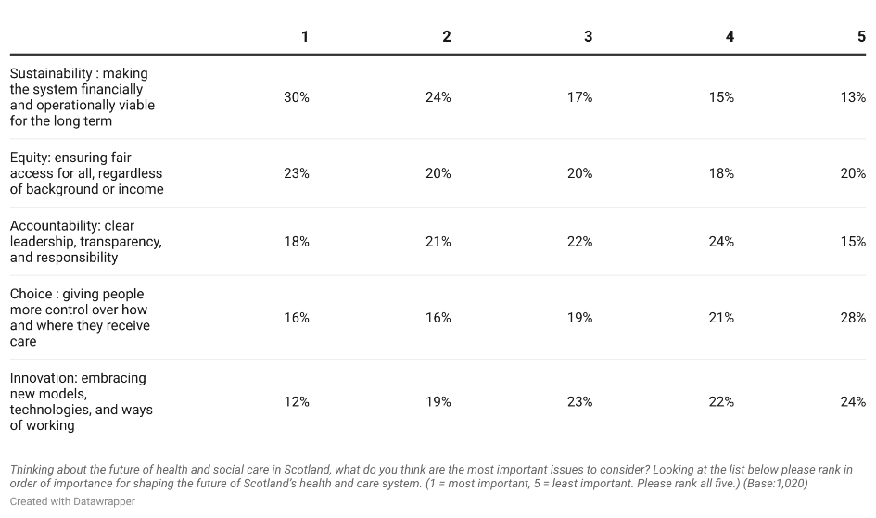
Sustainability and Equity seen as key future issue

Slide 13
Sustainability and Equity seen as key future issue
Proportion rating each measure as ‘1- most important’
Total | 16-24 | 65+ | Male | Female
Sustainability (30%) | Equity (35%) | Sustainability (33%) | Sustainability (30%) | Sustainability (31%)
Equity (23%) | Accountability (21%) | Equity (21%) | Equity (23%) | Equity (23%)
Accountability (18%) | Sustainability (20%) | Accountability (17%) | Accountability (19%) | Accountability (18%)
Choice (16%) | Choice (17%) | Innovation (15%) | Innovation (15%) | Choice (19%)
Innovation (12%) | Innovation (8%) | Choice (14%) | Choice (14%) | Innovation (10%)

Slide 14
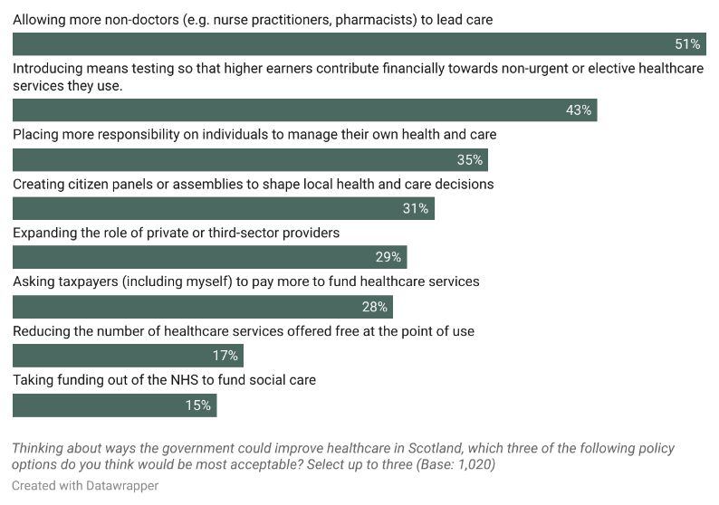
Public has a range of priorities to improve healthcare

Slide 15
And there is some consistency across the population
Total | 16-24 | 65+ | Male | Female
Allowing more non-doctors (e.g. nurse practitioners, pharmacists) to lead care (51%) | Introducing means testing so that higher earners contribute financially towards non-urgent or elective healthcare services they use (47%) | Allowing more non-doctors (e.g. nurse practitioners, pharmacists) to lead care (56%) | Allowing more non-doctors (e.g. nurse practitioners, pharmacists) to lead care (52%) | Allowing more non-doctors (e.g. nurse practitioners, pharmacists) to lead care (51%)
Introducing means testing so that higher earners contribute financially towards non-urgent or elective healthcare services they use (43%) | Allowing more non-doctors (e.g. nurse practitioners, pharmacists) to lead care (45%) | Placing more responsibility on individuals to manage their own health and care (43%) | Introducing means testing so that higher earners contribute financially towards non-urgent or elective healthcare services they use (44%) | Introducing means testing so that higher earners contribute financially towards non-urgent or elective healthcare services they use (42%)
Placing more responsibility on individuals to manage their own health and care (35%) | Placing more responsibility on individuals to manage their own health and care (35%) | Introducing means testing so that higher earners contribute financially towards non-urgent or elective healthcare services they use (41%) | Placing more responsibility on individuals to manage their own health and care (37%) | Placing more responsibility on individuals to manage their own health and care (33%)
Thinking about ways the government could improve healthcare in Scotland, which three of the following policy options do you think would be most acceptable? Select up to three (Base:1,020)

Slide 16
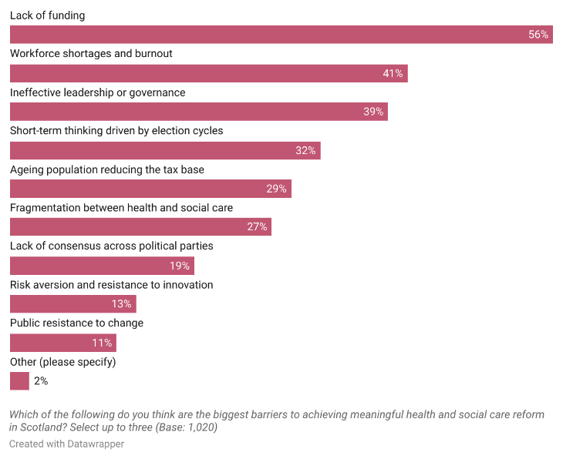
Barriers to change reflect public priorities – money and staffing

