Slide 1
Developing collaboration between schools
Prof Sir George Berwick CBE
Chief Executive

Slide 2
What are we trying to achieve?

Slide 3
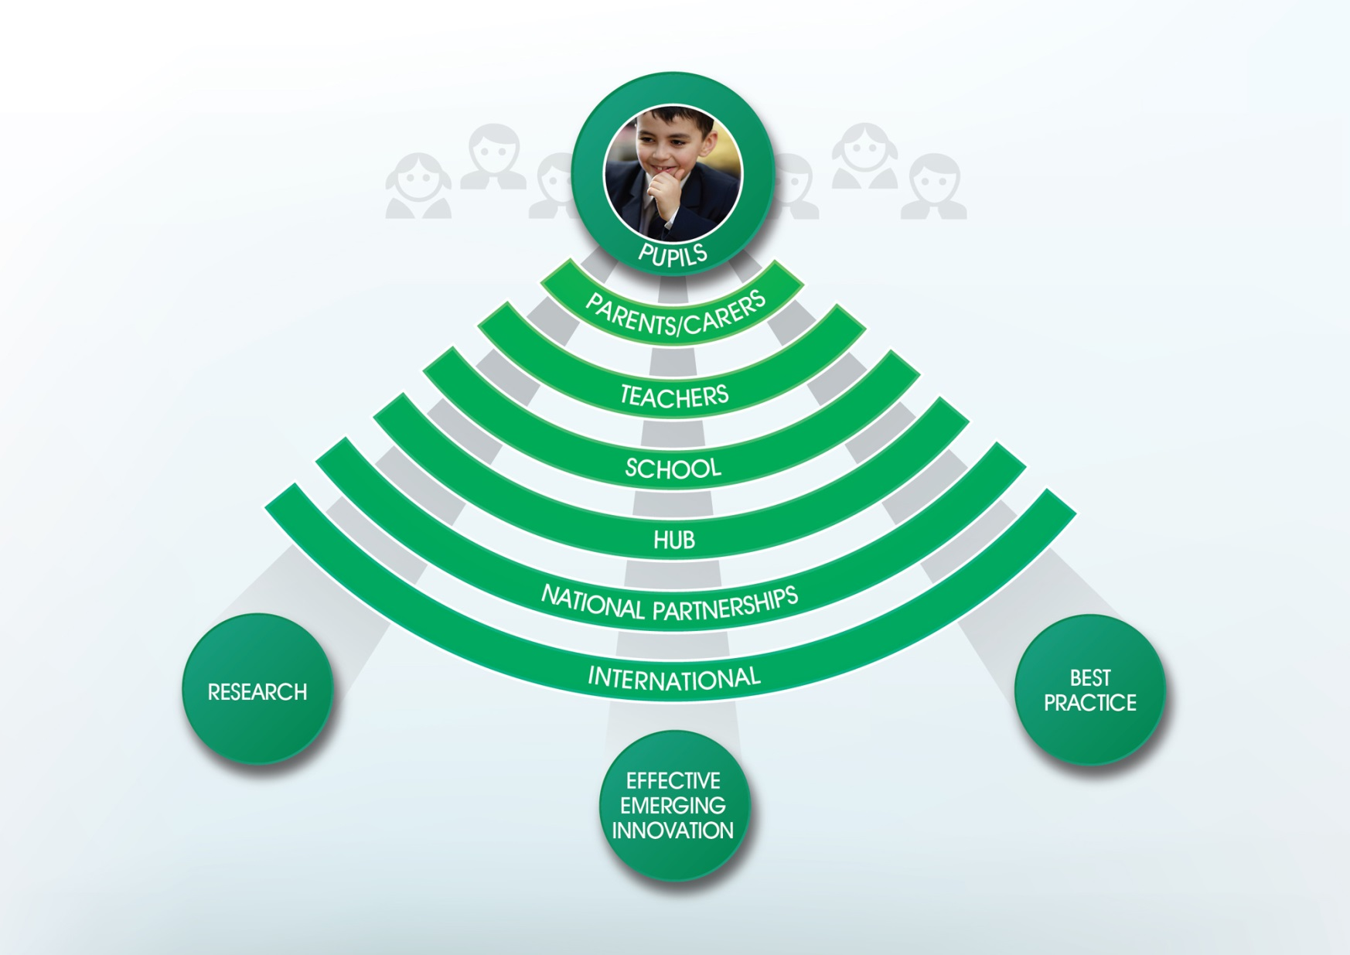
Ensuring that every pupil experiences the combined wisdom of the education community

Slide 4
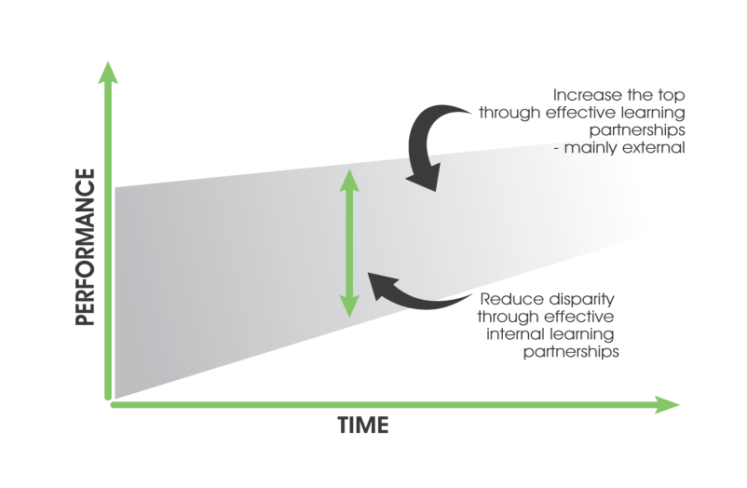
The ambition: upwards convergence in all our pupils’ achievements
A theory of action
Local Partnerships

Slide 5
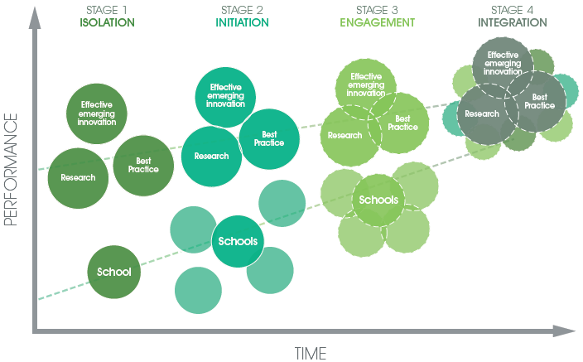
The approach: creating a virtuous learning community
Bringing together three bodies of knowledge in a structured way

Slide 6
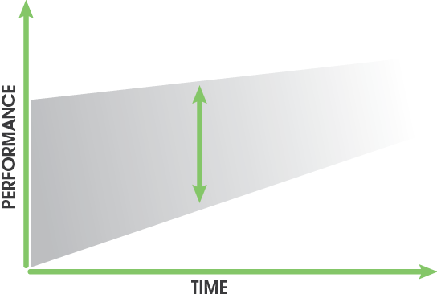
Upwards convergence in London
STAGE 1
DEVELOPING
STAGE 2
TIPPING POINT
STAGE 3
MATURE
37%
Outstanding
schools
27% (17%)
20%
15% (1%)
Underperforming
schools
2%
2%
Key
% of schools graded outstanding
% of schools carrying out support
% of schools in Special Measures
8%
21%
2002
2006
2010
2014
More on upwards convergence can be found in the book ‘Moral Capital’ www.georgeberwick.com/

Slide 7
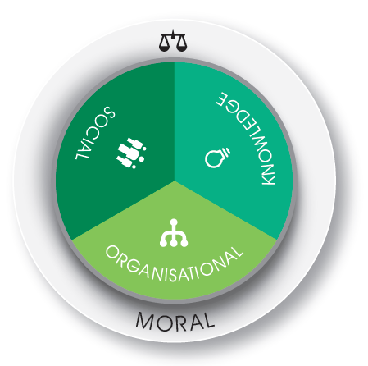
The Four Capitals
Putting in place the key components of effective knowledge management
Moral capital is the glue that binds us together.
It has to be constantly nourished, takes a long time to set and can rapidly become unstuck.

Slide 8
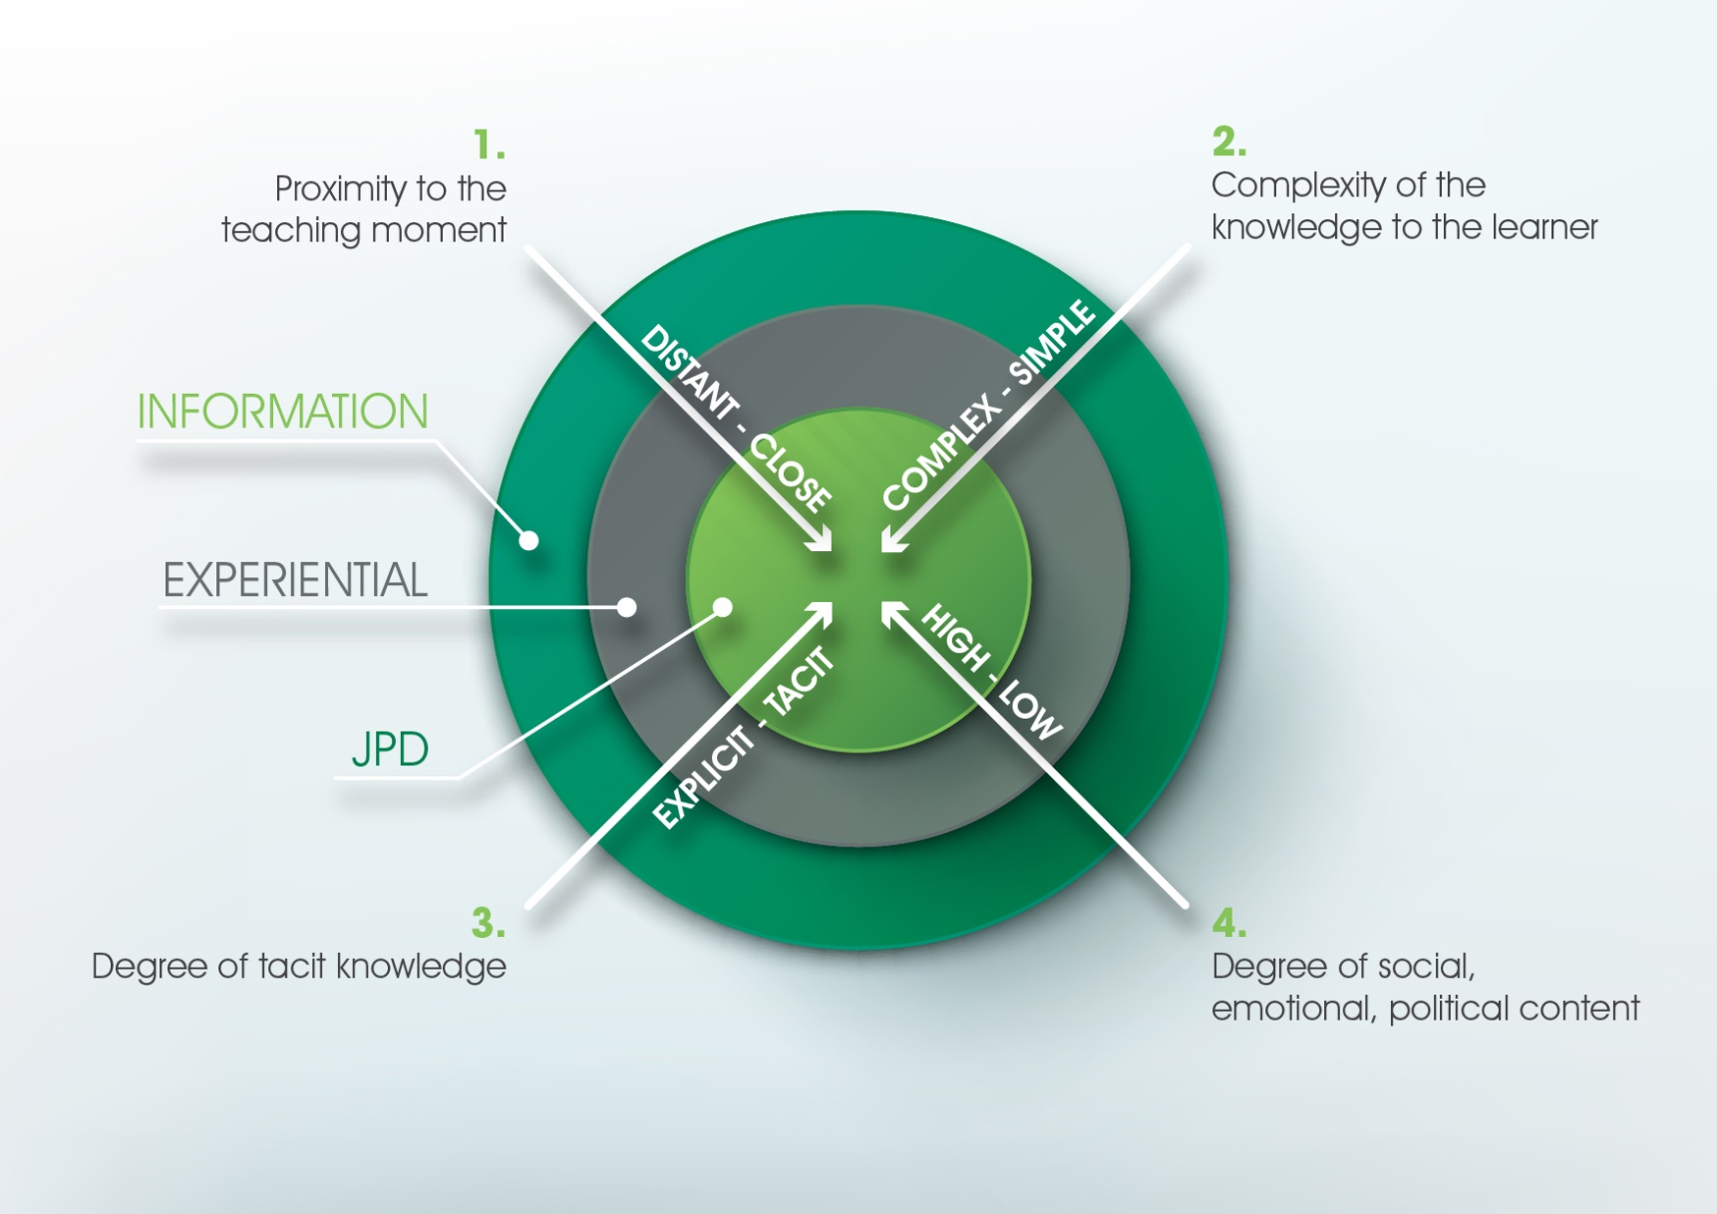
The nature of educational knowledge
Identifying the activity required for learning

Slide 9

Challenge Partners

Slide 10

300,000+ students
Network of Excellence
300+ Schools
34 Hubs
Challenge Partners
EAL (EEF)
Challenge the Gap
48 Schools
12 clusters
60 Schools
8 clusters
?

Slide 11
Our History: Ongoing lessons from school partnerships
An evolution of school-to-school programmes
Publication of exam results
Local Management of Schools
SCITT
Specialist Schools Trust
Ofsted
Beacon Schools
London Challenge
Leading Edge Schools
NLEs and National Support Schools
Olevi
City Challenges
National Teaching Schools
London Leadership Strategy
Teaching Schools
Education Endowment Foundation
Challenge Partners

Slide 12
Challenge Partners
Our impact starts with the young people we serve
Challenge Partners is a national network of local partnerships with a shared ambition and commitment to improving outcomes and reducing educational inequality for all children, not just their own, through effective collaboration.
We work from the premise that the skills and knowledge to lead improvement and meet challenges already exist in schools. All our activities are designed to share existing and catalyse the creation of new knowledge and solutions.

Slide 13
Our aims
Our impact starts with the young people we serve
1. Improve pupils’ examination results at a rate above the national average and accelerate the progress of the disadvantaged
2. Enable all schools to improve at a rate above the national average
3. Create more national leaders and outstanding schools that fulfil the Teaching School criteria
4. Develop a self-improving and sustainable system that contributes to national research and policy making

Slide 14

300,000+ students
Network of Excellence
300+ schools
34 hubs
Challenge Partners
EAL (EEF)
48 schools
12 clusters
Challenge
the Gap
60 schools
8 clusters
?

Slide 15
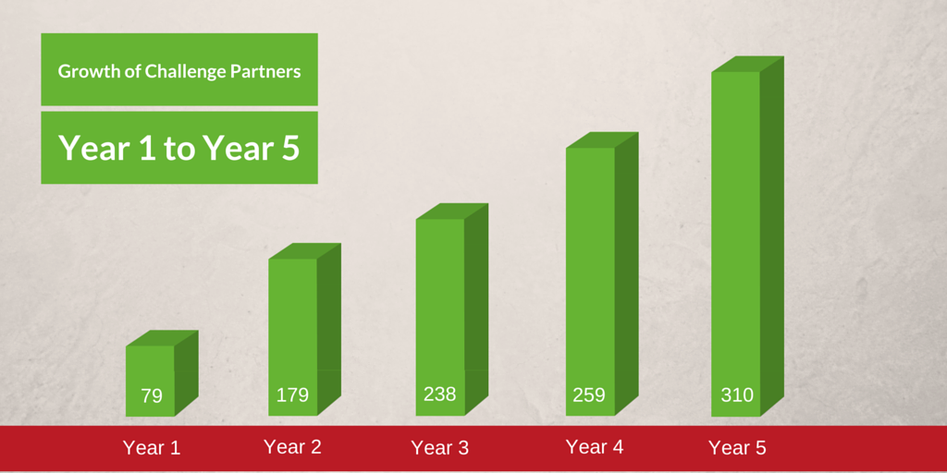
Growth of the Network of Excellence

Slide 16
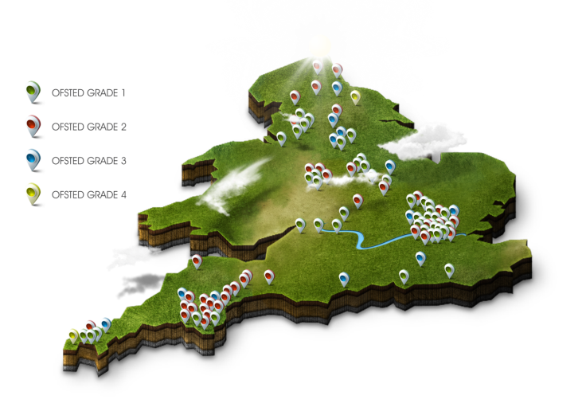
A growing Partnership
A national network of local partnerships
310 Schools
34 Hubs
200,000 Pupils

Slide 17
Network of excellence
Challenge and support for your school
Support for your
local partnership
Be part of a
national partnership
Quality Assurance Review (QA Review)
annual peer review
CPD for senior leaders to review other schools
areas of excellence
Identify support for your improvement objectives
follow-up conversation to QA Review
sign-posting to NLEs, SLEs and areas of excellent practice
Funding to facilitate a menu of support
ITP, OTP, OTAP
NLE/SLE support days
subject reviews
research projects
Research and evidence driven approach to collaboration
researched framework
coaching
SLE deployment
training to run Challenge the Gap
Engage with best practice
online tool to identify best practice schools like you
free places on national conferences and events
international visits
Collectively solve challenges
through phase or theme specific forums
share emerging practice
contribute to research and policy
All schools contribute £7/pupil pa (minimum £2,900 and maximum £11,000)
©Challenge Partners - not to be used without consent

Slide 18
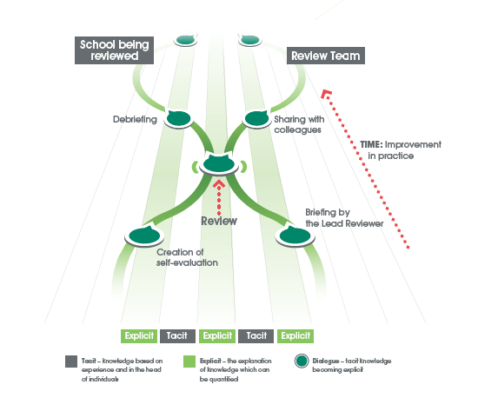
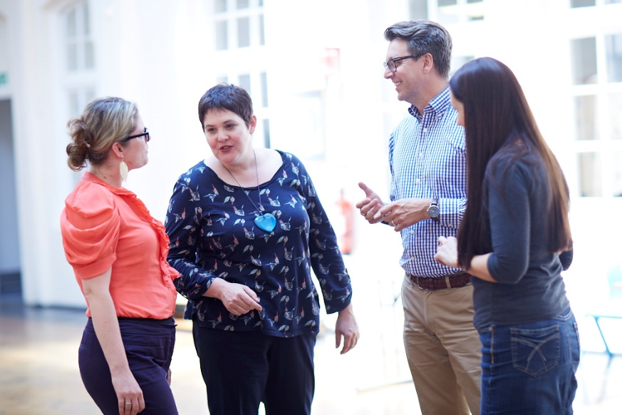
The Quality Assurance Review
Sharing of ideas and good practice
Making tacit knowledge explicit
Over 700 reviews have happened across the country
Trained over 1600 senior leaders as reviewers
Senior Leaders rate the quality of CPD at 9 out of 10

Slide 19

300,000+ students
Network of Excellence
300+ schools
34 hubs
Challenge Partners
EAL (EEF)
48 schools
12 clusters
Challenge
the Gap
60 schools
8 clusters
?

Slide 20

Our Approach
Staff at all levels work to understand the barriers to learning for target pupils in your school before scaling up the most effective practice
The School Journey
Whole school
Environment for success
High attainment
Successful learners
FSM pupils
Leaders
Target Cohort
Teachers
Effective pedagogy
Para-professionals
Effective interventions
Notes:
Our Approach
Every school context is different. That’s why we believe that long-term solutions need to be driven from within. Challenge the Gap works across all levels of a school to deliver a lasting, transformational impact on staff and their ability to tackle educational disadvantage, according to their own pupils in their own context.
How Does It Work?
NB: An explanation of the programme should include a variation of all aspects covered below:
CtG focuses on a Target Cohort of vulnerable, underperforming pupils.
Your school’s CtG Team, made up of a leader, teacher and para (in primary schools – secondary schools bring two teachers and three paras), works together and with Teams from other local schools to understand the barriers to learning for your school’s Cohort.
Your Team are given access to the latest research and best practice, which they combine with their own experience, school context, and pupil data.
Challenge the Gap Teams jointly develop effective strategies to overcome the barriers to learning of their Target Cohort.
Monitoring the progress of these pupils, your Team selects the most effective strategies to scale up in your own school.
The leader creates an environment for change; the teacher introduces effective pedagogy; the para-professionals lead targeted, evidence-based interventions.
This leads to a whole school approach for narrowing the gap.

Slide 21



What is the Impact for Challenge the Gap Schools?
Year 1: Target Cohort
Year 2: Whole School Improvement
Targeted pupils make accelerated progress at an average of 4 terms’ progress in 3 terms after one year.
Attendance of persistently absent pupils increased by 8 percentage points over their year on the programme.
Impact across the school
Change in school culture
In-school expertise
Strong relationships with local schools
Notes:
Impact in Year 1: After the first year on the programme, you should expect to see significant changes in your target cohort in terms of their attendance, behaviour, participation and attitude to learning.
These non-academic factors should then start to play a large role in accelerating the academic progress of these pupils. By unpicking the activities and initiatives that affect this change in your target cohort, your Challenge the Gap team can begin rolling out strategies that work more widely.
Importance of Year 2: the second year on the programme is where impact starts to be seen across the school. Participants comment on a change in school culture, using outcomes to inform and change school ethos, and seeing significant impact on attainment and removing barriers to learning, not just for the target cohort but for vulnerable pupils across the school.
Staff on their second year in the programme model collaborative leadership. The choice for schools in their second year and beyond is whether they want to deepen the expertise they already have within their original team, developing champions for disadvantaged pupils.
Some examples of whole school practice from the second year of the programme include:
An ‘Accountable Talk’ programme increasing literacy and spoken participation in class
Improving participation and resilience by praising effort over attainment
Developing the quality and consistency of marking and feedback to build resilience and self-aware learning

Slide 22
What is the Impact for Challenge the Gap Schools?
What teachers say about Challenge the Gap
"Challenge the Gap has given us the tools to raise the profile of pupils from a disadvantaged background at Pickhurst Infants, so we are now really focused on high outcomes for these pupils. No-one slips through the net“
Leader, Pickhurst Infant Academy, Kent
"The cross-school experience was amazing! All of our schools saw improvements in the quality of our pupils' writing, even the higher ability. On top of that, it was a fantastic learning process for me: I learnt so much from working closely with colleagues in other schools."
Leader, Summerville Primary School, Manchester
“Challenge the Gap is the only programme I am aware of that engages schools in something meaningful across phases over a sustained period. It has been an amazing thing to see how powerful it is.”
Victoria Eadie, Headteacher, Feltham Community
Notes:
Include best quotes on this page

Slide 23

300,000+ students
Network of Excellence
300+ schools
34 hubs
Challenge Partners
Challenge
the Gap
60 schools
8 clusters
EAL (EEF)
48 schools
12 clusters
?

Slide 24
What have we learnt so far?

Slide 25
7 Key Points from the Theory of Action
Build a network around parallel rather than individual catalysts
Identify, capture and grow best practice
Build moral capital to drive moral purpose
Understand the nature of the knowledge so that it can be transferred effectively
Provide professional, constructive challenge
Collaborate to solve problems of student achievement
Allow the hub to grow organically
The quality of the people define the effectiveness of the collaboration

